Slide 1


TRANSFORMER COUPLED CLASS A POWER AMPLIFIER
ANALOG ELECTRONICS
BY
BADIGINENI MUKESH KUMAR (vtu-6569)
ECE DEPARTMENT
II YEAR

Slide 2
Definition :
Amplifier
An amplifier, electronic amplifier or amp is an electronic device that can increase the power of a signal
Class A Amplifiers are the most common type of amplifier class due mainly to their simple design. Class A, literally means “the best class” of amplifier due mainly to their low signal distortion levels and are probably the best sounding of all the amplifier classes
Transformer-coupled Class A amplifier is given as: An output transformer improves the efficiency of the amplifier by matching the impedance of the load with that of the amplifiers output impedance

Slide 3
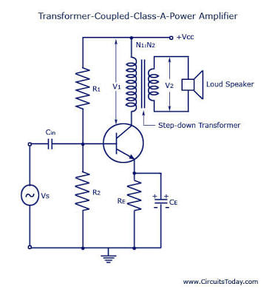
Circuit diagram :
Impedance Matching.
The power transferred from the power amplifier to the load (say a loudspeaker) will be maximum only if the amplifier output imped­ance equals the load impedance R_{L}. This is in accord­ance with the maximum power transfer theorem. This is accomplished by using a step-down transformer of suitable turn-ratio.

Slide 4
Circuit Operation :
In this circuit dc (winding) resistance deter­mines the dc load line. Typically, this resistance is quite small (assumed to be zero) providing dc load to be a vertical line rising from V_{cc}, as shown. When an ac signal is applied to the base of the transistor the collector current will vary around the operating point Q.
In order to have maximum ac power output, the peak value of collector current due to input ac signal alone should be equal to the zero-signal collector current. To achieve this, the operating point Q is located at the Centre of the ac load line. When ac signal is applied, collector current fluctuates from maximum to minimum (zero), and operating point Q moves up and down the load line.
At the peak of +ve half cycle of the input signal, I_{c} _{max} = 2 I_{c} and V_{ce} _{min} = 0
while at the peak of -ve half cycle of i/p signal I_{c} _{min} = 0 and V_{ce} _{max} = 2 V_{cc}.
Thus Vce varies in opposite phase to the Ic. The variation of Vc appears across primary of the transformer. Now ac voltage is induced in the transformer secondary which in turn develops ac power and supplies to the load

Slide 5
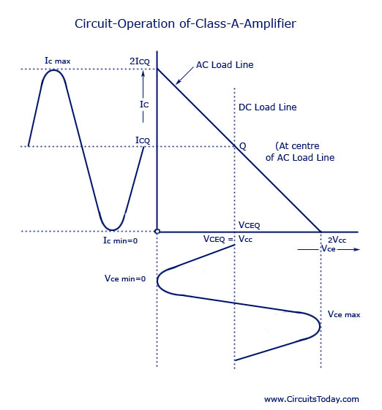
Circuit Operation :
Ic min ₌ collector current
Vcc = collector voltage
Vce = emitter voltage

Slide 6
Circuit analysis :
In an ideal transformer, there is no voltage drop in primary so V_{CEQ} = V_{CC} and power input to the transistor becomes equal to the dc power drawn from the collector supply V_{cc} as power loss in the primary is negligibly small. Thus power input to the transistor, P_{tr} = Power drawn from collector supply, P_{in} _{(dc)} = V_{CC} ICQ and overall efficiency becomes equal to collector efficiency and = Pout (ac)/ V_{CC} I_{CQ}
Under condition of development of maximum ac power, voltage swings from V_{ce} _{max} to zero and collector current from I_{c} _{max} to zero. So
V_{rms} = 1/√2 { [V_{ce} _{max} – V_{ce min}]/ 2 } = V_{ce} _{max}/2√2 = 2V_{CC}/2√2 = V_{CC}/√2
And
I_{rms} = 1/√2 { [I_{c} _{max} – I_{c min}]/ 2 } = I_{c} _{max}/2√2 = 2I_{CQ}/2√2 = I_{CQ}/√2
AC power developed across the load,
P_{out (ac)} = V_{rms} I_{rms} = (V_{CC} I_{CQ})/2
Collector efficiency = P_{out (ac)}/ (V_{CC} I_{CQ})/2 ÷ V_{CC} I_{CQ} = 0.5 or 50%.
Thus for a transformer-coupled class A power amplifier the maximum theoretical efficiency is 50%. In practice, the efficiency of such an amplifier is somewhat less than 50%. It is about 30%.
The efficiency of a transformer-coupled class A power amplifier can be given as
Efficiency = 50 *{ [V_{ce} _{max} – V_{ce min}]/ [V_{ce} _{max +} V_{ce min}]} %
The larger the value of V_{ce} _{max} and smaller the value of V_{ce min} the closer the efficiency approaches the theoretical limit of 50%. Well-designed circuits can approach the limit of 50%. The larger the amount of power handled by the amplifier, the more critical the efficiency becomes!

Slide 7
Advantages:
No signal power is lost in the collector or base resistors.
An excellent impedance matching and can be achieved in a transformer coupled amplifier.
Due to excellent impedance matching, transformer coupling provides higher gain.
Disadvantages:
It has a poor frequency response.
The coupling transformers are bulky and fairly expensive at audio frequencies.
Frequency distribution is higher i.e. low frequency signals are less amplified as compared to the high frequency signals.
Transformer coupling tends to introduce hum in the output.
Cost is also more.
These are mostly employed for impedance matching.
Applications :
These are used as driver amplifiers sometimes used as an output amplfiers.

Slide 8
THANK YOU
1

